Slide 1

Phone-Based
Relationship Estimation
Machine Learning Population Heterogeneity
Presenter：李沛瑶

Slide 2
Catalog
Introduction
Related Work
Methods and Data
Results

Slide 3
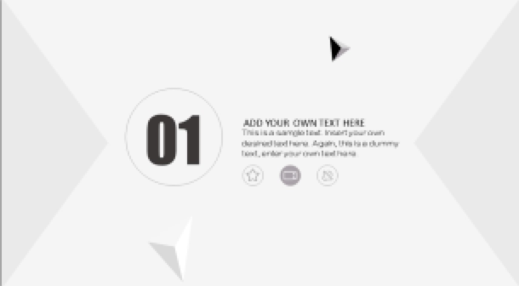
01
Introduction

Slide 4

Introduction
A
Global Goals
Using cell phone sensing data to estimate the type and quality of interpersonal relationships
B
Background
Mental illness become more common
Personal interpersonal relationship factors
C
Previous work
Feature modalities
Small samples from narrow groups
D
Improvements
Automated Machine Learning Model Training
Contextualization of communication patterns

Slide 5
02
Related Work

Slide 6
Related Work
Use feature patterns such as communication logs, Bluetooth proximity, and geolocation tags to build machine learning models that estimate social relationships.
Small samples of narrow groups to build machine learning models
Problem
Rough category differentiation and existence
of group overlap
Unclear relationship and semantic location between communication events and demographics
Expectation
Richer information on interpersonal relationship granularity classification and demographics
Problem
Training samples have potential propensity to communicate and are not generalizable
Expectation
Machine learning models are highly accurate and statistically significant and generalizable

Slide 7
03
Methods And Data

Slide 8
Data
Participants
Data Collection
Individuals 18 years of age or older who have an Android smartphone with WiFi access (no mental illness, no walking impairment, no alcohol abuse)
Purple Robot (ecords communication and text messages, latitude and longitude location and sensor information)
EMA (prompts participants to answer questions about their contacts)
Demographics
Pre-processing
152 male, 33 female, 4 unspecified
152 white, 23 black, 6 Asian, 5 Indian, 3 unspecified race
119 employed, 36 unemployed, 16 disabled, 4 retired, 14 unspecified occupational status
164 living in metropolitan areas, 24 non-metropolitan areas, from 37 different states
Delete the "Other" category
Communication volume approximates the level of social support
Estimated relationship roles for the top 5 contacts
Remove contacts who communicate infrequently

Slide 9
Communication Features
• intensity and regularity: features that consider the volume and regularity of communication, such as mean or median weekly calls or number of study days with a logged communication.
• temporal tendency: features that capture the time of day or day of week when communication events typically occur.
• channel selection and avoidance: features that capture any asymmetry in communication (incoming vs. outgoing) or preference for calls vs. SMS.
• maintenance cost: features that consider the amount of effort in maintaining communication relationships.

Slide 10
Features
Demographic Features
Demographic information includes age, gender, ethnicity, education level, marital status, employment status and whether the participant lives alone.
Communication Features
Demographic Features
Semantic Location Features
Raw GPS information is converted to higher level features by K-means clustering.
The summary counts of all communication events for each contact are normalised to obtain the relative proportion of communication events that occur at semantic locations.
Missing Data Imputation
Semantic Location Features
Missing Data Imputation
Common but needs proper handling
Data loss is non-random, estimating missing features can provide more information for predictive models

Slide 11

Predictive Modeling
01
02
03
AutoML
Auto-sklearn
Selection of more promising parameters for initialization
Bayesian optimization
The final ensemble model
Cross Validation
Training models with grouped K-flod cross-validation to ensure that the models do not over-fit the training data to produce meaningful performance results
Feature Importance Analysis
SHAP, based on Python, interprets the output of any machine learning modelReflects the influence and positivity of features in each sample

Slide 12
04
Results

Slide 13
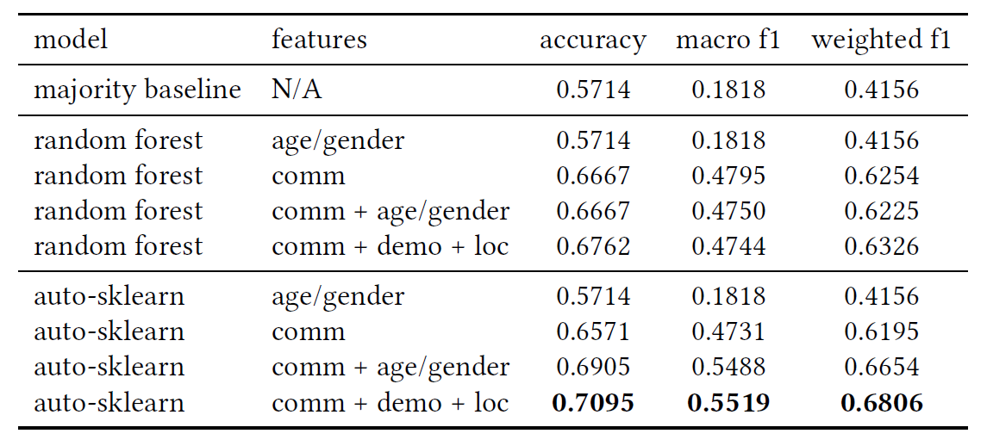
Four-class Relationship Prediction Performance
Four feature sets
age and gender, communication features, communication features + age/gender, communication features + demographic features + semantic location features
Four relationship categories
social relationships living separately, family members living together, colleagues, Task
Data analysis
There seems to be an interaction effect between age/gender and other features.
Notes:
当把年龄和性别加入到我们的 准确率提高了3.4%，加权F1提高了4.5分。而在年龄和性别的基础上加入其他人口统计学和位置特征，其性能提升要小得多

Slide 14
Feature Importance
The amount of communication, regularity, and temporal trend communication feature modality have a significant impact on the model output.
For individuals, the most important characteristic is the total number of days of communication, a characteristic that separates social separate from family together because it encompasses both the regularity and volume of communication.
Through SHAP analysis, we also found that the timing and amount of communication were key determinants of the nature of participants' relationships with intimacy.
Through SPH analysis, we found that the characteristics that had the greatest impact on communication patterns were demographic characteristics, particularly age. We concluded that participant demographics did not have a direct effect on model output, but rather that the interaction between age and propensity to communicate helped to better predict relationship performance.

Slide 15
Dissusion
The results of this work inform future research that measures the amount of communication between people and their closest contacts as a marker of mental health. Considering that social networking interventions have been found to be effective in reducing disconnection between individuals with serious mental health conditions, the passive perception of mobile phone-based communication patterns could inform such technology-mediated interventions. In addition to being useful for digital interventions, mobile phone-based measures of close contact person communication may eventually become part of the assessment of mental illness treatment effectiveness.
The robustness of such models needs to be validated for a broader population. Future personal perception studies need to consider demographic data as well as objective model evaluation techniques to obtain meaningful and actionable results.

Slide 16
Thanks
Presenter: 李沛瑶

